Slide 2
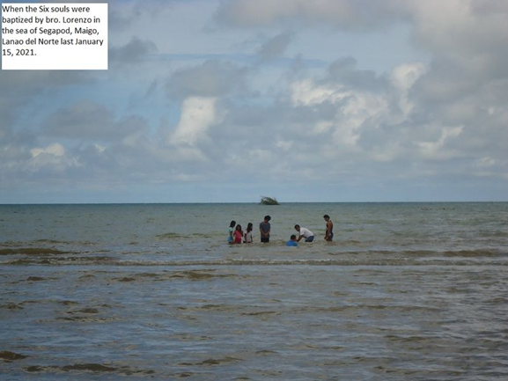
Leo and Evanlee Entroso

Slide 3
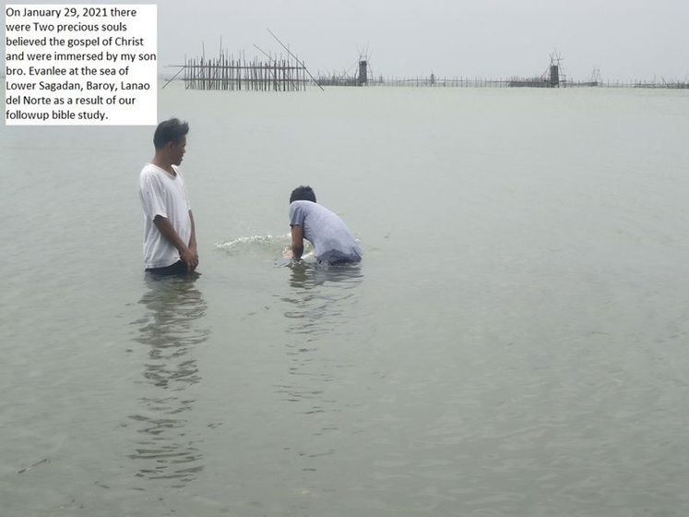
Leo and Evanlee Entroso

Slide 4
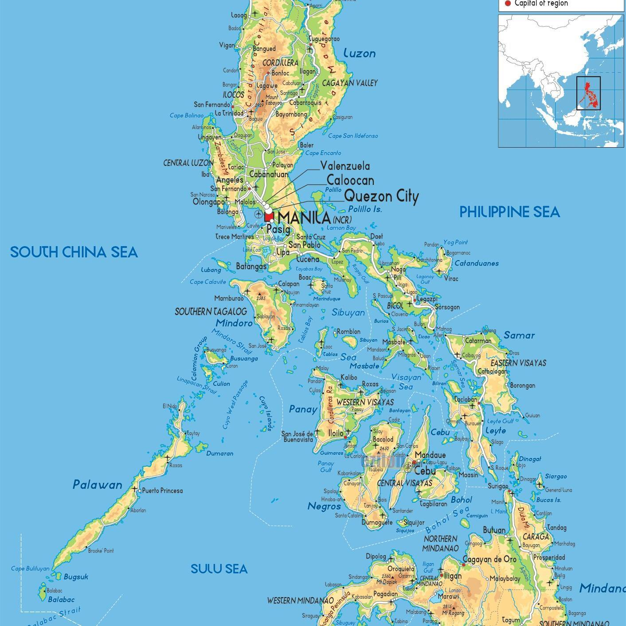
Mindanao

Slide 5
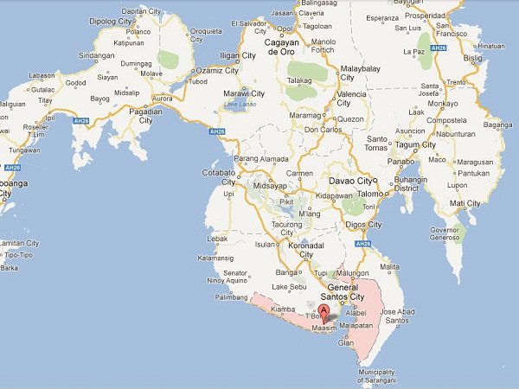
Lanao del Norte

Slide 6
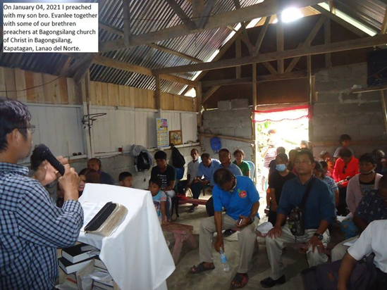
Bagongsilang church of Christ

Slide 7
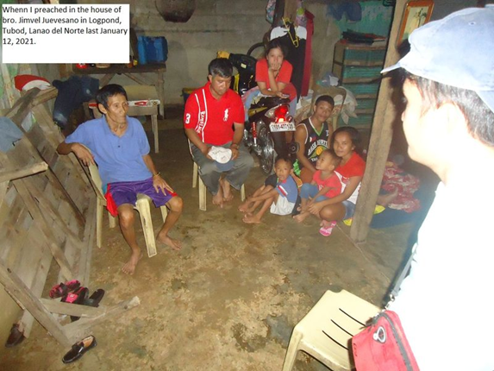
House of Jimvel Juevesano

Slide 8
The captive
Daniel 1.1-7

Slide 9
1) The Great Defection
2 Kings 23.26,27
2 Kings 23.35-37
Leviticus 26.27,28; 32-35
2 Chronicles 36.15-21

Slide 10
2) The Great Deportation
Daniel 1.2-7
“Then the king instructed Ashpenaz, the master of his eunuchs, to bring some of the children of Israel and some of the king’s descendants and some of the nobles,….

Slide 11
2) The Great Deportation
“…young men in whom there was no blemish, but good-looking, gifted in all wisdom, possessing knowledge and quick to understand, who had ability to serve in the king’s palace, and whom they might teach the language and literature of the Chaldeans” Dan. 1.3,4

Slide 12
2) The Great Deportation
The PHYSICAL TEST (v.4)
The INTELLECTUAL TEST
The SOCIAL TEST
Their CURRICULUM

Slide 13
2) The Great Deportation
The BRAINWASHING
Daniel (“God is my Judge”)
Belteshazzar (“Bel, protect his life”)
Hananiah (“Yahweh is gracious”)
Shadrach (“The command of Aku”)

Slide 14
2) The Great Deportation
Mishael (“Who is what God is”)
Meshach (“Who is what Aku is”)
Azariah (“Yahweh is my Helper”)
Abednego (“Servant of Nebo”)

Slide 15
3) The Great Decision
(v.8) “Daniel PURPOSED in his heart…”
Every major conviction we have is a conviction we need to make long BEFORE it’s tested.
Daniel RESOLVED to do what was right.

Slide 16
4) The Great Demonstration
The greater IMPACT. (v.15)
The greater INTELLIGENCE. (v.17,20)
The greater INFLUENCE. (v.18,19)
“Thus Daniel continued…”
Dan. 1.21

Slide 17
5) The Application
A life that was STEADFAST.
The PREPARATION.
The PROMISE.
God will help us live like Daniel

Slide 18
Marriage is hard
Divorce is hard
CHOOSE YOUR HARD

Slide 19
Being in debt is hard
Being financially disciplined is hard
CHOOSE YOUR HARD

Slide 20
Communication is hard
NOT communicating is hard
CHOOSE YOUR HARD

Slide 21
Life will never be easy. It will always be hard.
But we can choose our hard.
CHOOSE WISELY

