Slide 1
Philip and the Ethiopian
Acts 8.1-8, 26-39

Slide 2
Philip
Selected as one of “seven men of good report” Acts 6
A preacher; “scattered abroad” due to persecution. Acts 8.1,4
Paul stayed with him. Acts 21.8

Slide 3
Philip
“The multitudes with one accord heeded the things spoken by Philip.” Acts 8.5,6
Many believed, including Simon the sorcerer and the Ethiopian eunuch.

Slide 4
Philip’s Reassignment
Successfully & effectively proclaimed the gospel in Samaria. Acts 8.6
Then, in v.26, he’s given a reassignment.

Slide 5
Philip’s Reassignment
Go to a “desert”…..
What???

Slide 6
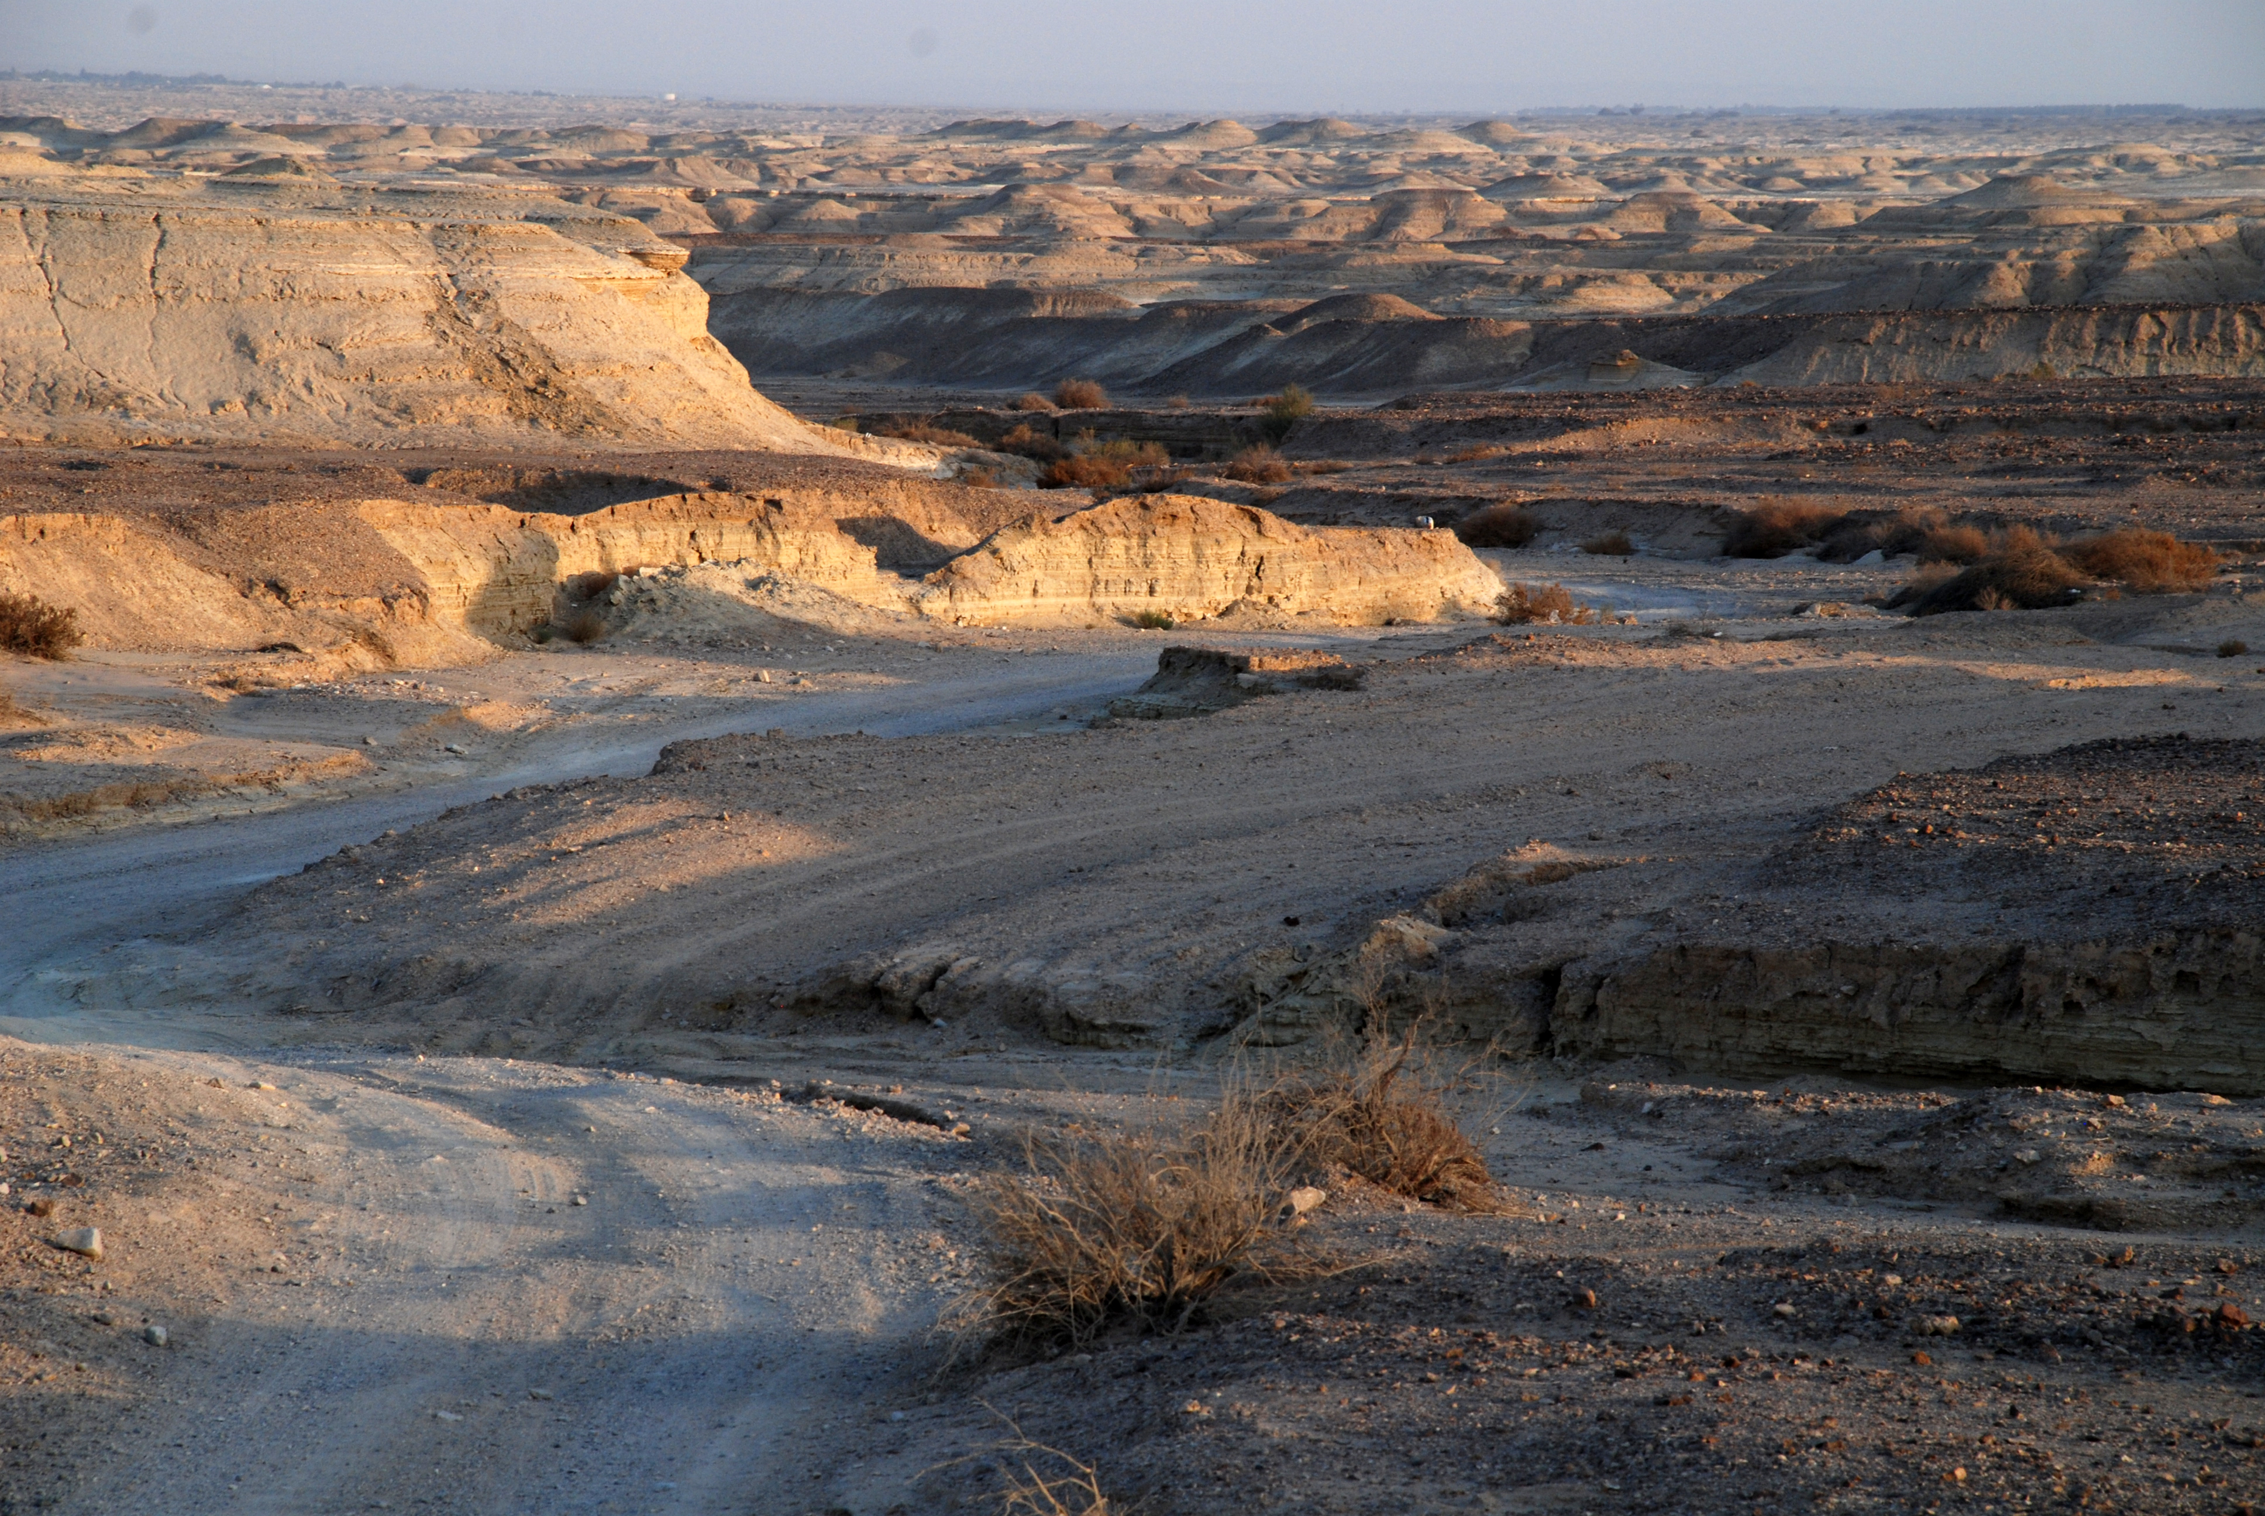
Philip’s Reassignment

Slide 7
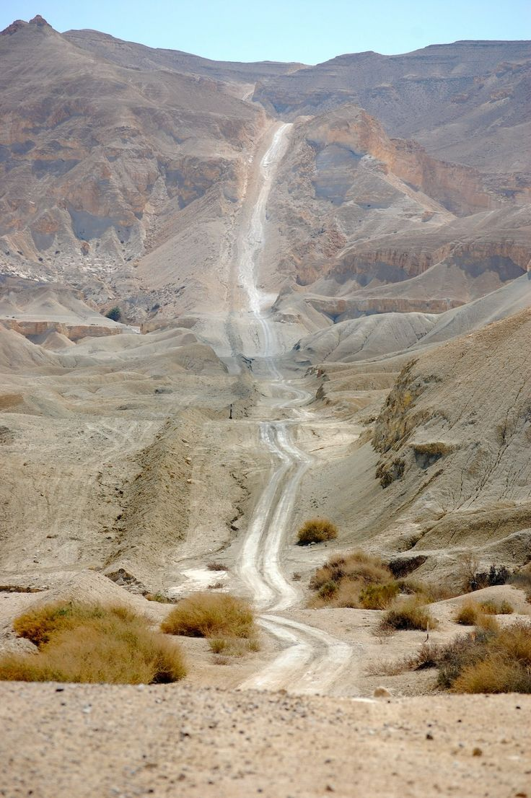
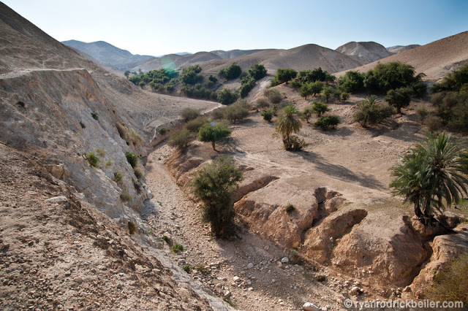
Philip’s Reassignment

Slide 8
Philip’s Reassignment
Then, in v.26, he’s given a reassignment.
Go to a “desert”???!
“But, my work is producing results here!”

Slide 9
Chance?....or Divine providence?
Not chance! God was ordering Philip’s steps.
Philip’s reassignment was by Divine appointment.
It had nothing to do with Philip.

Slide 10
The Ethiopian
Ethiopia was in north Africa; ~200-300 mi. south of Jerusalem.
A eunuch. Deut. 23.1; Isa. 56.3-5
Most likely a proselyte to Judaism.
Came to Jerusalem to worship.

Slide 11
Isaiah 53.7,8
Why is he reading Isaiah?
By chance?
He’s reading about Jesus as the suffering Servant.

Slide 12
Isaiah 53.7,8
“He was led as a sheep to the slaughter; and as a lamb before it’s shearers is silent, so He opened not His mouth.

Slide 13
Isaiah 53.7,8
In His humiliation His justice was taken away, and who will declare His generation?
For His life is taken from the earth.”

Slide 14
Isaiah 53.7,8
“He was led as a sheep to the slaughter.”
He’s not just reading the Old Testament, he’s reading about the Christ!

Slide 15
The Conversion
The Ethiopian did not comprehend the text.
It is not enough to desire salvation, one must understand God’s plan of salvation.
Matt. 13.23; 1 Pet. 1.23-25

Slide 16
The Conversion
The prerequisites for teaching the lost:
An INQUIRING mind.
A PREPARED heart.
And a READY ANSWER.
Rom. 10.17; 1 Pet. 3.15

Slide 17
“…and the Spirit of the Lord caught Philip away…”
The response:
“the eunuch saw him no more; and he went on his way REJOICING.” v.39
Was the same response back in Samaria: “…and there was GREAT JOY in that city.” v.8

