Slide 1
Five Marks to Spiritual Maturity
PHILIPPIANS 3.12-16

Slide 2
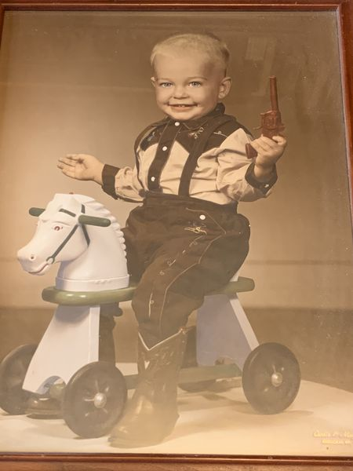

Slide 3
The task of the preacher & teacher is to see Christians come to spiritual maturity.
Col. 1.28:
“We PREACH Him, warning every man and TEACHING every man in all wisdom, that we may present every man perfect in Christ.”
So, is there a standard to be used to determine spiritual maturity?

Slide 4
#1 The Christian is aware of what
they are NOT
Phil. 3.10,11
Paul proclaims that his greatest longing is to KNOW CHRIST.
v.12: “Not of course, that I have already attained, or am already perfected.”
Knowing this is in itself a mark of maturity.
1 Cor. 10.12

Slide 5
#2 The Christian is assured of what
he IS
Phil. 3.12 “…Christ Jesus has also laid hold of me”
John Newton wrote:
“I have ever to confess with sorrow, that I am far from being what I ought to be; and far from what I wish to be; but also blessed be God’s Name, I am far, very far from what I once was.”
Phil. 1.6

Slide 6
#3 The Christian has a healthy disregard for the past
Phil. 3.13 “…but one thing I do, FORGETTING THOSE THINGS WHICH ARE BEHIND…”
Paul doesn’t mean past lessons or God’s goodness to him in the past.
Our past successes can give us a sense of pride.
Our past failures can paralyze us into inactivity and despondency.
There is no bright future for the Christian who wastes time dwelling in the past.

Slide 7
#4 The Christian lives with a positive, single-minded desire for that which lies ahead.
Phil. 3.13 “…but one thing I do, forgetting those things which are behind and REACHING FORWARD TO THOSE THINGS WHICH ARE AHEAD.”
Some translations say, “I STRAIN ON to what is ahead.”
Paul has goals. Do you? Are they God-framed?
“I’m pressing on the upward way, new heights I’m gaining every day. Still praying as I’m onward bound, Lord plant my feet on higher ground. Lord lift me up and let me stand, by faith on Heaven’s table-land; a higher plane than I have found, Lord plant my feet on higher ground.”

Slide 8
#5 The Christian holds true to the principles which unite believers in Christ: God’s Word.
Phil. 3.15,16 “Therefore let us, as many as are mature, HAVE THIS MIND, and if in anything you think otherwise, God will reveal even this to you. Nevertheless, to the degree that we have already attained, LET US WALK BY THE SAME RULE, LET US BE OF THE SAME MIND.”
All that we do as believers must be framed within the context of God’s word…and we must put the spiritual family first…to work in harmony.

