Slide 2
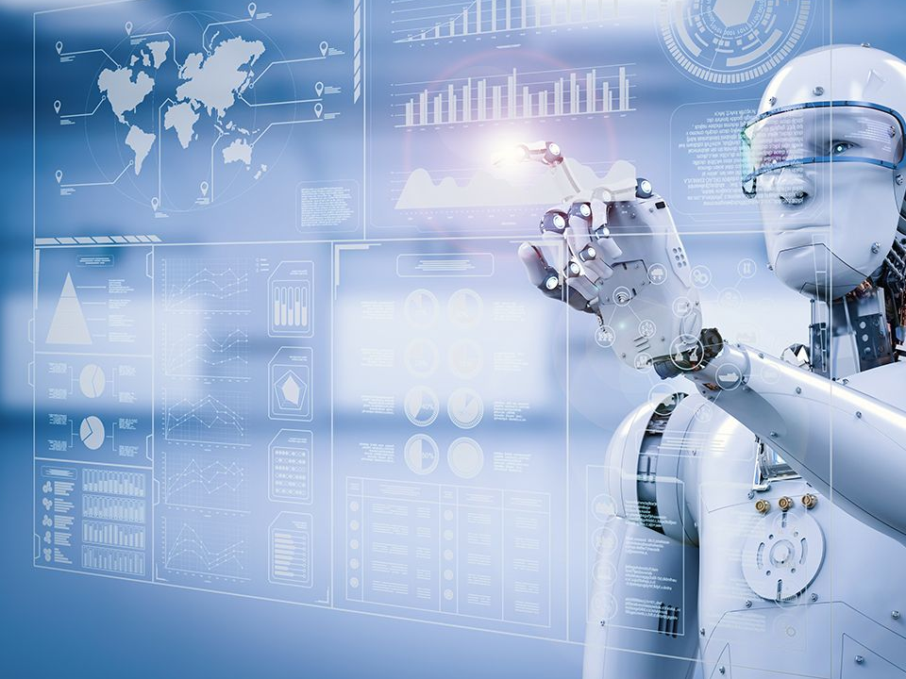
Modern
Family

Slide 7
FWIW IM JK LOL TBH NO FOMO DQMOT IDK TTFN ILY

Slide 8
Expectations

Slide 9
Expectations
“ME”

Slide 10
Expectations
“ME”
“truth” – John 17:17
1 Corinthians 8:6
Hebrews 2:10

Slide 11
Expectations
Future
Flee – 2 Timothy 2:22
Philippians 4:11-13
1 Timothy 6:6-10

Slide 12
Expectations
Imbalance
Joshua 24:14-15
Matthew 6:33
Titus 2:3-5

Slide 13
Expectations
Numbing
Proverbs 23:29-35

Slide 14
Expectations
Escaping
1 Peter 4:15
1 Thessalonians 4:11

Slide 15
Expectations
Perfection

Slide 26
Expectations
Hating
Ephesians 4:29
Colossians 3:12
1 Corinthians 13:4

Slide 27
“…strangers and pilgrims on the earth…”
Hebrews 11:13-16

