Slide 1
The State of the church

Slide 2
The state of the lord’s church
I’m concerned about the Lord’s church in this country…and the world in general.
Why the decline??

Slide 4
Why the decline?
We live in a culture where the social media thrives.
Exposes us to all kinds of alternative options for worship…and everyone claims acceptance by God.
The religious world offers a richer worship experience (so most people think).

Slide 5
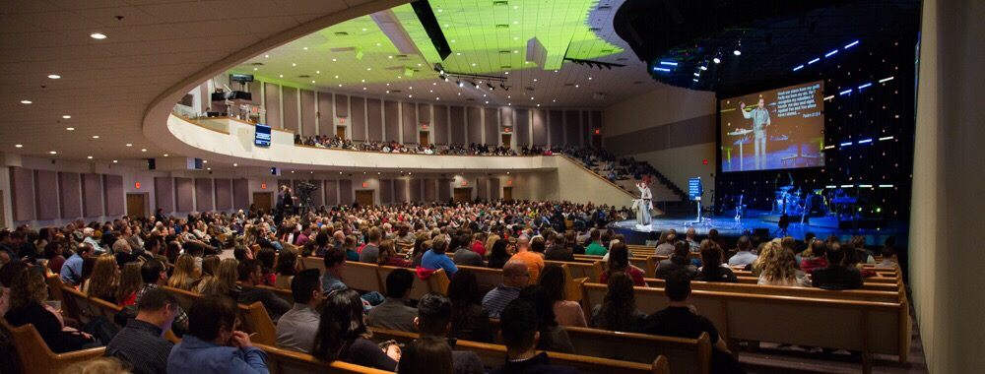
Why the decline?

Slide 6
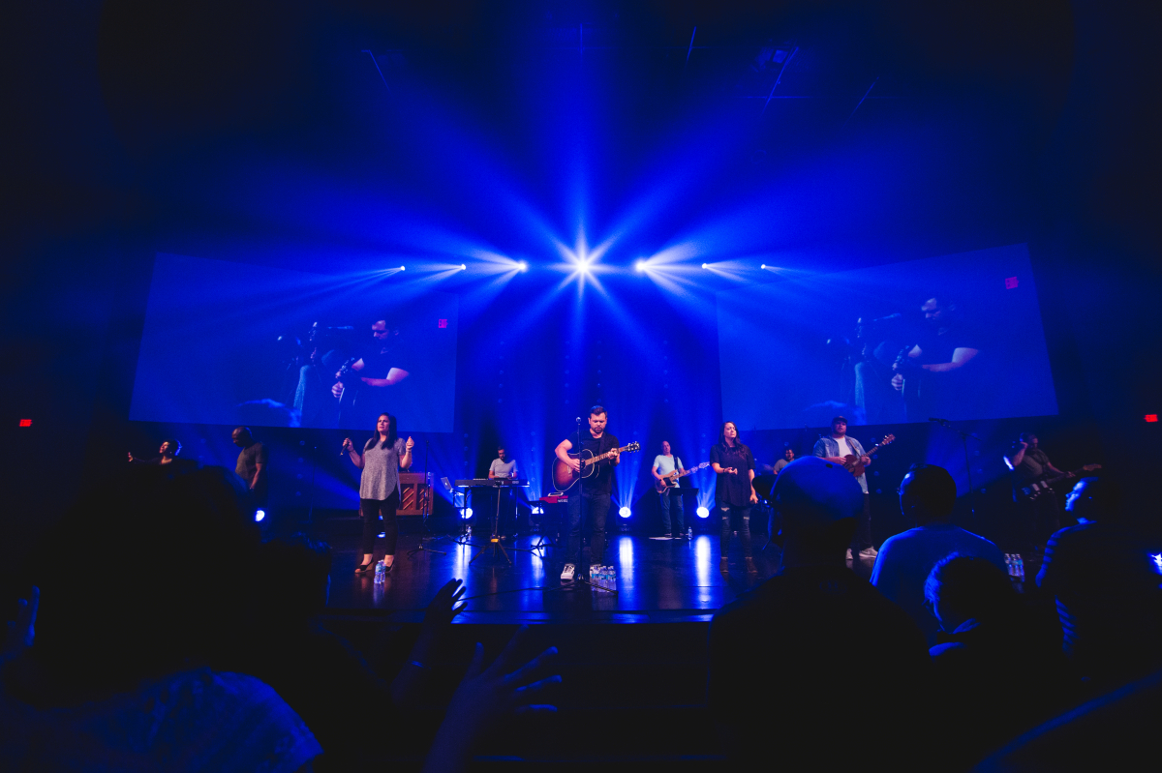
Why the decline?

Slide 7
Why the decline?
They don’t teach a doctrine of involvement and work that’s required for salvation.
Jesus said, “If you love Me, you will keep my commandments” -- John 14:15
We have a culture that is tolerant of nearly everything, and actively targets those who aren’t.

Slide 8
Why the decline?
Are we seriously working within our community to attract unbelievers?
“What have I done personally to reach the lost?”
It’s a fair question.

Slide 9
So, what’s the solution?
Keep doing the things we’ve been doing that are critical:
Keep teaching the ‘unsearchable riches of Jesus Christ”.
Do NOT dilute the truth:
…but, say what Paul said, “I did not shrink from declaring unto you the whole counsel of God”
And to those false teachers in Jerusalem, he said, “…to them we did not yield submission, not even for an hour.”

Slide 10
Emulate the church of Jerusalem in acts 2:42-47
It was a TEACHING, LEARNING community.
“they continued steadfastly in the apostles doctrine (teaching)”. v.42
The church that ceases to teach, ceases to exist.
Hosea 4:6 “My people are destroyed for lack of knowledge.”
The church had a responsibility to master the truth, and be mastered by it.

Slide 11
Emulate the church of Jerusalem in acts 2:42-47
It was a WORSHIPPING community.
“they committed themselves to the breaking of bread and the prayers”. v.42
You cannot have a worshipping church, until you have an informed church.
….because, you cannot worship that which you do not know…
John 4:23 “…for the Father seeks such to worship Him.”

Slide 12
Emulate the church of Jerusalem in acts 2:42-47
They were a CARING, SERVING community.
“…and sold their possessions and goods, and parted them to all men, as every man had need”. v.44,45
Acts 11:28,29 (every man sent relief)
2 Cor. 8:1-5 (Macedonian Christians gave…)
Acts 6:1,2 (Grecian widows were supported).
1 John 3:16-18

Slide 13
Emulate the church of Jerusalem in acts 2:42-47
They were a FELLOWSHIPPING community.
“…and they continued steadfastly in the apostles doctrine and fellowship…”. v.42,46,47
“fellowship” (gr. Koinonia) means “to share”
Denotes close relationship, or partnering of those with a common goal.

Slide 14
So, in closing…..

