Slide 1
Joseph In Egypt

Slide 2
Joseph’s Egyptian Name
Genesis 41:45 – “Pharaoh named Joseph Zaphenath Pa’aneah”

Slide 3
Zaphenath
Likely “djedu en ef” – pronounced like Zatenaf
Djedu en ef means “He who is called”
Zatenaf transposed by Hebrews to Zafenat – a case of metathesis

Slide 4
Pa’aneah
More correctly, it is pa-Aneah.
Pa means “the”
Ankh – the Egyptian sign for life – pronounced like “aneah”
Pa-Aneah – “the one who lives” or “the one who brings life”

Slide 5
Putting It All Together
Joseph, Zaphenath Pa’aneah
Joseph, he who is called Pa’aneah
Joseph, he who is called “The one who lives”
Joseph, he who is called “The one who brings life”

Slide 6
The Vizier Ankhu

Slide 7
The Vizier Ankhu
Ankhu – a shortened version of pa-Aneah, retaining the same meaning
Served in the 12th and 13th Dynasties between Amenemhat III and Sobekhotep I
The Middle Kingdom of Egypt

Slide 8
Ankhu the Biblical Joseph?
Ankhu – “Overseer of the fields”
Genesis 41:33-36 – Joseph building granaries for storage during the years of plenty
Egyptian documents – “The Granaries of Ankhu”

Slide 9
Ankhu the Biblical Joseph?
Genesis 41:33-36 – Joseph collecting a fifth of the harvest to store
Ankhu established a new government department – “The Department of the People’s Giving”

Slide 10
Ankhu the Biblical Joseph?
Ankhu became a suddenly popular name, especially among Asiatics – slaves from Joseph’s region.
Texts of the time refer to “Ankhu pa-Aam”. That is, “Ankhu the Asiatic.”

Slide 11
Ankhu the Biblical Joseph?
Genesis 41:46 - Joseph began serving Pharaoh at age 30.
Genesis 50:26 – Joseph dies at 110.
Roughly 80 years of service.

Slide 12
Ankhu the Biblical Joseph?
Ankhu served from
Amenemhat III ~ 1665 BC
to Sobekhotep I ~ 1585 BC
Approximately 80 years of service

Slide 13
Plenty & Famine

Slide 14
Pharaoh’s Dream
Genesis 41:17-24
Seven fat cows and seven skinny cows coming up from the Nile
Seven ripe ears of grain and seven withered ears of grain scorched by the east wind

Slide 15
The Nileometer
Egyptians measured the annual flood level
Taxes on harvest based on the flood level versus the low-water level
Higher floods meant higher taxes and typically better crops

Slide 16
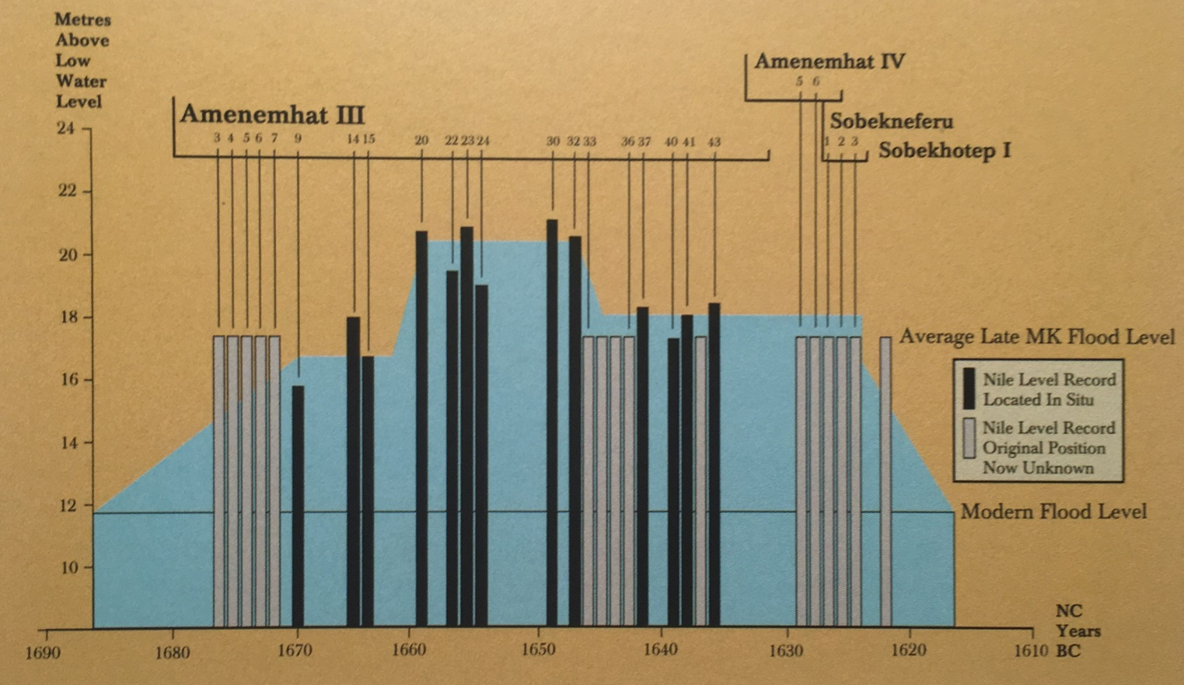
Years of Plenty

Slide 17
Years of Flooding

Slide 18
Consolidation of Property
During the flood years, there is a consolidation of power under Amenemhat III
Evidence of a swift drop in the power of landowners.
Genesis 47:20

Slide 19
Flood Relief
Year 20 of Amenemhat’s reign – severe flooding
Cut a channel to divert water from the flooding Nile to a reservoir basin

Slide 20
Flood Relief

Slide 21
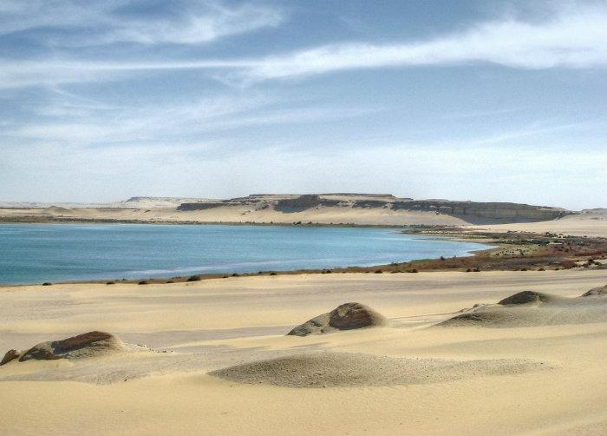
Lake Moeris

Slide 22
Bahr Yussef

Slide 23
Avaris and Ramesses
Cities in the land of Goshen
Ramesses built over the top of Avaris

Slide 24
Avaris and Ramesses

Slide 25
Syrian Mittelsal Haus

Slide 26
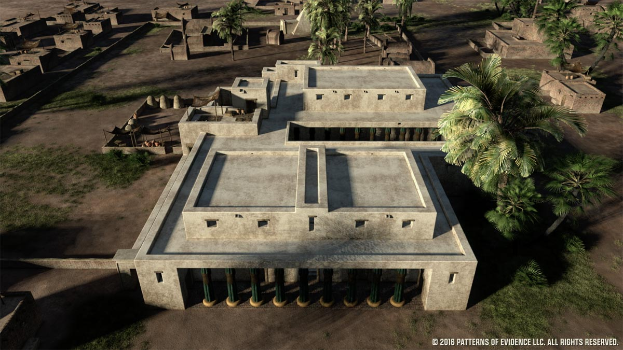
Egyptian Official’s House

Slide 27
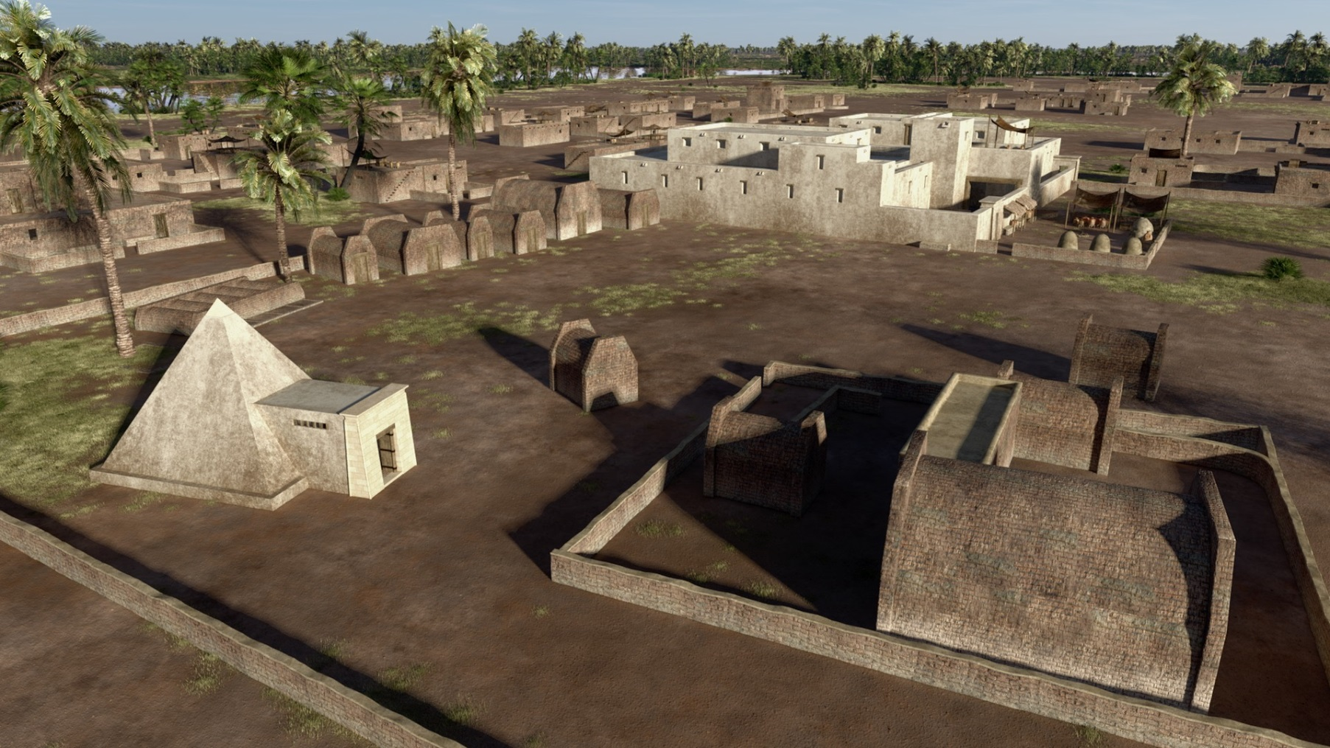
12 Main Tombs

Slide 28
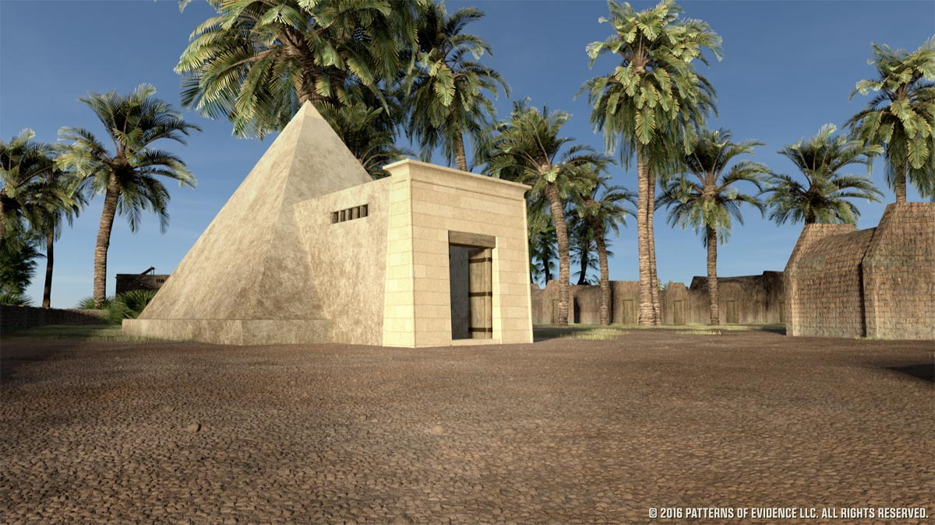
Pyramid Tomb

Slide 29
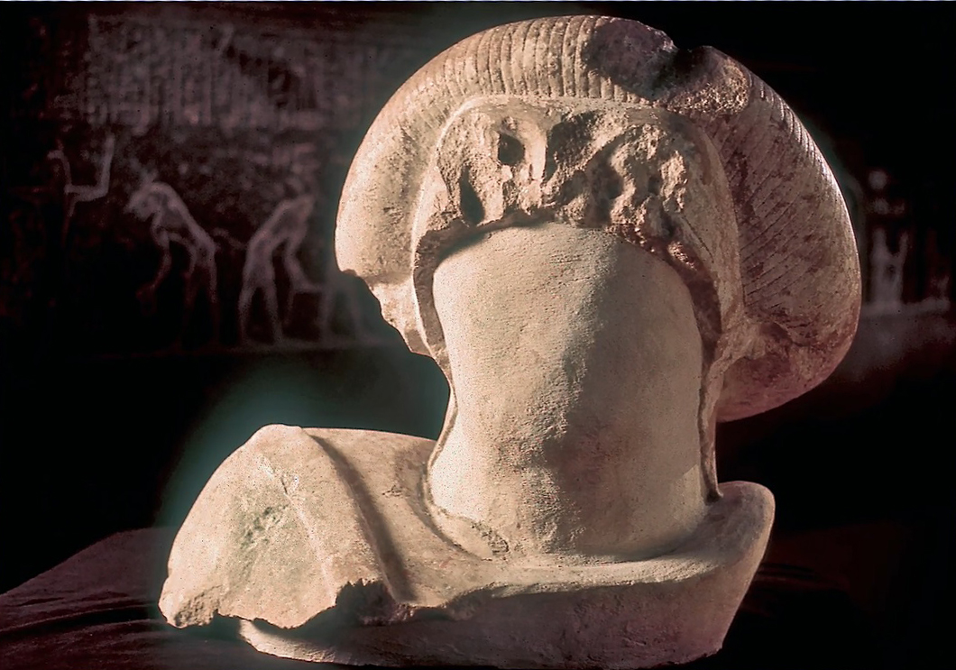
Statue

Slide 30
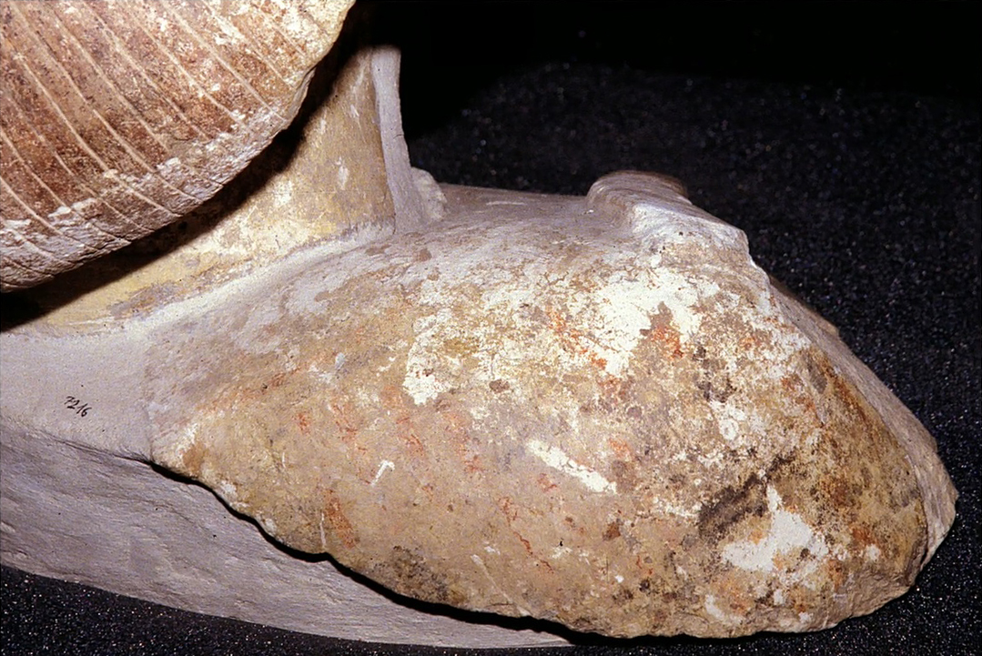
Statue

Slide 31
Statue

Slide 32
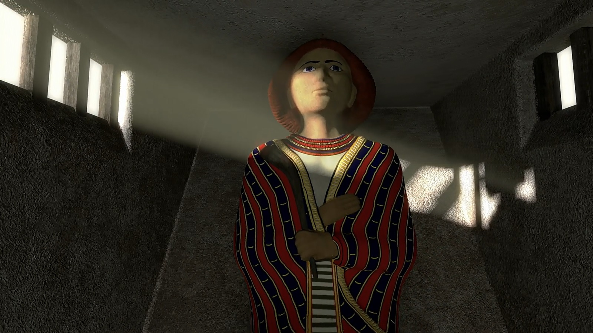
Statue

Slide 33
Contents of the Tomb
No body, no grave clothes, no grave goods
Grave robbers don’t take bodies
Genesis 50:25 – “Carry my bones up from here.”

