Slide 1
United In Spite Of Differences
Learning to work together in spite of our many differences.
Notes:
11-8-15 – Richmond, MO
Our nation is one which prides itself on its diversity. We are the “melting pot” of the world. So, it goes without saying that many differences exist in this great land. Sometimes these differences threaten to tear us apart, as in the difference of opinion over slavery in the Civil War. Yet, at other times our differences are set aside. At least, twice in our land we have gladly set aside our differences.

Slide 2
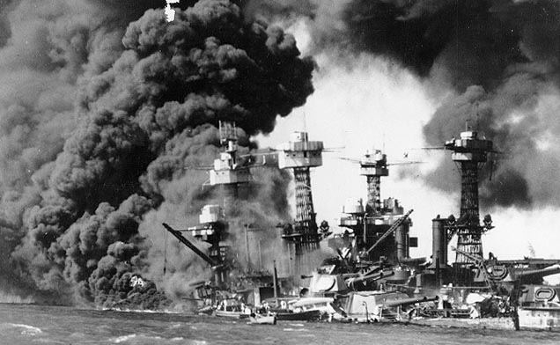
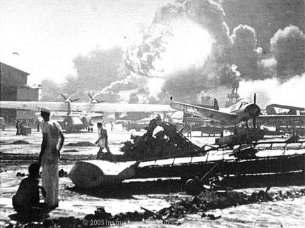
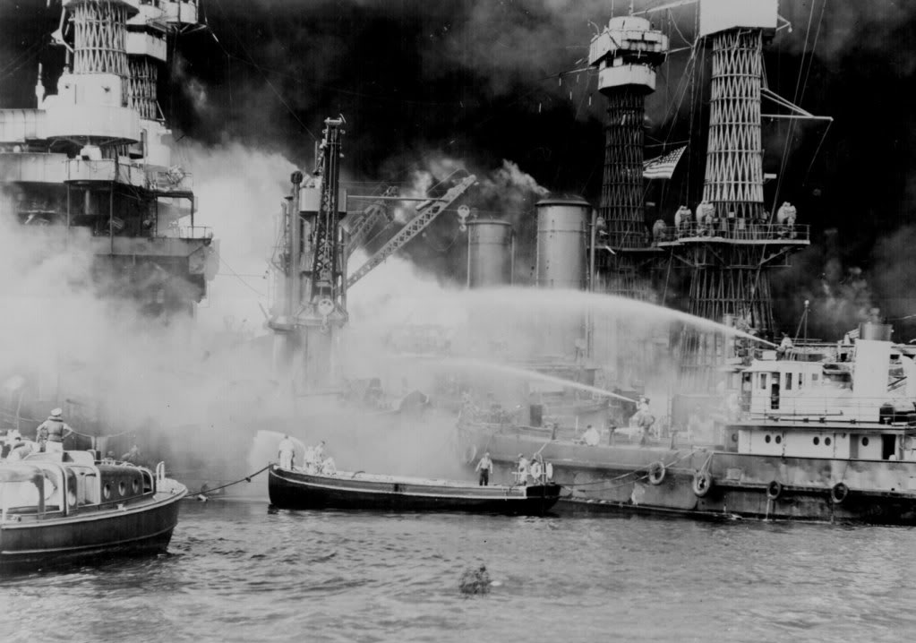
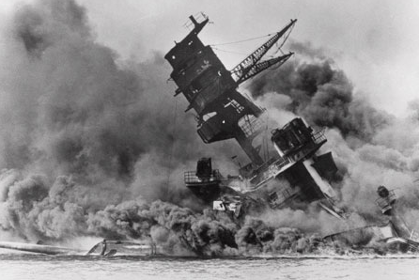
December 7, 1941

Slide 3
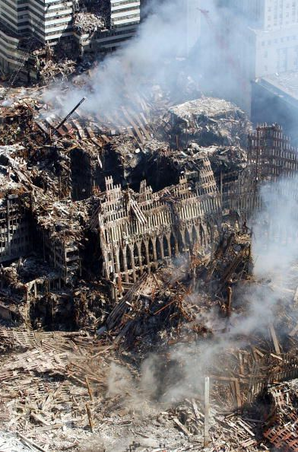
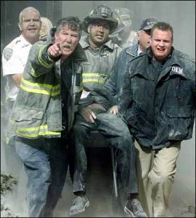
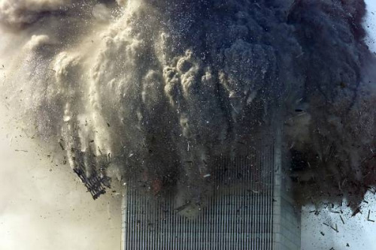
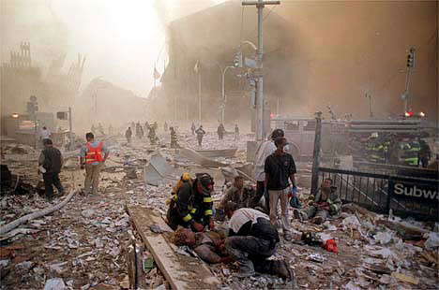
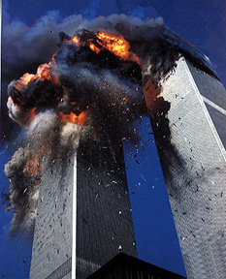
September 11, 2001

Slide 4
What united our nation?
A Common Goal
Vengeance on our attackers.
A Common Enemy
Japanese
Al Qaeda

Slide 5
The Lord’s Church
Differences
No distinctions
Romans 10:8-13
“Jew and Greek”
1 Corinthians 12:12-13
“whether Jew or Greek, whether slave or free”
Galatians 3:28
“neither Jew nor Greek…slave nor free…male nor female”
Colossians 3:9-11
“Greek and Jew, circumcised and uncircumcised, barbarian, Scythian, slave and freeman”
Romans 10:8-13
“Whoever will call upon the name of the Lord will be saved”
1 Corinthians 12:12-13
“we were all baptized into one body”
Galatians 3:28
“you are all one in Christ Jesus”
Colossians 3:9-11
“Christ is all, and in all”

Slide 6
What will unite God’s People?
We have been made one in Christ and thus, in spite of our many differences, we now have a:
Common goal
Common enemy

Slide 7
One in Christ for One Purpose
A common goal
Glorifying God
1 Corinthians 6:20 – I must glorify God.
2 Corinthians 9:13 – I must cause other saints to glorify God.
Matthew 5:16 – I must cause sinners to glorify God.
Pleasing God
1 Thessalonians 4:1 – “please God”
2 Corinthians 5:9 – “pleasing to Him”
Colossians 1:10 – “please Him in all respects”

Slide 8
One in purpose but still different!
How do we handle these differences?

Slide 9
If our common goal is glorifying and pleasing God. . .
Some differences are insignificant
Romans 14:1-4 – personal scruples
1 Corinthians 6:4-7 – personal loss
Some differences are significant
1 Corinthians 5:1-2 – immorality
Romans 16:17 – false teaching
We will treat the insignificant differences as insignificant and the significant differences as significant.

Slide 10
If our common goal is glorifying and pleasing God. . .
Regarding insignificant differences
We will accept one another – Romans 15:7
“To receive to oneself, admit to one's society and fellowship, receive and treat with kindness” Zodhiates
We will bear with and tolerate one another Colossians 3:12-14; Ephesians 4:2
“put up with” Strong
We will be longsuffering – Eph. 4:2; Col. 3:12
Remember our goal is not what pleases us!
Romans 15:1-6

Slide 11
If our common goal is glorifying and pleasing God. . .
Some things are not an issue anymore
Feelings getting hurt.
Not being consulted on remodel decisions.
Getting accidentally overlooked for ______.
Personality quirks.
Little or petty things.
We will not let them distract us from our ultimate goal of glorifying and pleasing God.

Slide 12
If our common goal is glorifying and pleasing God. . .
Regarding significant differences
If in sin – restore – Galatians 6:1
If won’t repent – withdraw – 1 Corinthians 5:5
If in opposition – correct – 2 Tim. 2:24-26
If won’t repent – withdraw – Romans 16:17
Remember our goal is not what pleases us!
1 Corinthians 5:2
Notes:
If won’t repent, withdraw – 1 Cor. 5:5 - Salvation is the goal of the withdrawal – We are willing to do whatever is necessary to return them to the Lord.
Remember our goal is not pleasing me - If I am arrogant I’ve placed my wishes above God’s and therefore I’m pleasing myself and not God.

Slide 13
If our common goal is glorifying and pleasing God. . .
Some things will always be significant
A brother in sin – Galatians 6:1; James 5:19-20
Sin in the church – 1 Corinthians 5:2
False teachers – 1 Timothy 1:18-20
False teaching – Revelation 2:14-15
We will deal with these, regardless of the discomfort, in gentleness, with patient study, constant visits and, if necessary, loving withdrawal.

Slide 14
Differing on our Differences
What if we differ on whether our differences are insignificant or significant?
Follow Paul’s instructions
Romans 14:1-9, 19; 15:2
Consider Paul’s exhortations
Philippians 2:1-4
Consider a possible solution
1 Corinthians 6:5

Slide 15
Final Quotation
“We do not always have a “map” of the territory we must traverse, but the goal of glorifying God is our “compass.” This reliable compass will lead us through the dangers of divisiveness and disruption.”
Gary Henry

Slide 16
United In Spite Of Differences
Learning to work together in spite of our many differences.

Slide 17
December 7, 1941

Slide 18
September 11, 2001

Slide 19
What united our nation?
A Common Goal
Vengeance on our attackers.
A Common Enemy
Japanese
Al Qaeda

Slide 20
The Lord’s Church
Differences
No distinctions
Romans 10:8-13
“Jew and Greek”
1 Corinthians 12:12-13
“whether Jew or Greek, whether slave or free”
Galatians 3:28
“neither Jew nor Greek…slave nor free…male nor female”
Colossians 3:9-11
“Greek and Jew, circumcised and uncircumcised, barbarian, Scythian, slave and freeman”
Romans 10:8-13
“Whoever will call upon the name of the Lord will be saved”
1 Corinthians 12:12-13
“we were all baptized into one body”
Galatians 3:28
“you are all one in Christ Jesus”
Colossians 3:9-11
“Christ is all, and in all”

Slide 21
What will unite God’s People?
We have been made one in Christ and thus, in spite of our many differences, we now have a:
Common goal
Common enemy

Slide 22
One in Christ Against One Enemy
A common enemy - Satan
1 Peter 5:8 - adversary
Revelation 12:9-11 – serpent of old, accuser
Matthew 13:19 – the evil
The character of our enemy
Liar & murderer – John 8:44
Disguiser – 2 Corinthians 11:14
Deceiver – Revelation 12:9

Slide 23
One in Christ Against One Enemy
The goal of our enemy
Devour – 1 Peter 5:8
Sift like wheat – Luke 22:31-32
Tempt to sin – 1 Cor. 7:5; Matt. 4:3; 1 Thess. 3:5
Take advantage of – 2 Corinthians 2:11
Hinder – 1 Thessalonians 2:18
We live in enemy territory
1 John 5:19; 2 Corinthians 4:4

Slide 24
Consider
Given the nature of our enemy, to what extent must we devote ourselves to handling and conquering this enemy?
Be alert – 1 Peter 5:8
“to watch, to refrain from sleep” – Zodhiates
Isn’t this a matter which necessitates we keep our differences in perspective?
Insignificant as insignificant and significant as significant!

Slide 25
Consider
Understanding who our enemy is will prevent us from making a big deal out of insignificant matters and cause us to treat more seriously those matters of significance.
I must be willing to overlook petty differences in our fight against our common enemy.

Slide 26
Treating Brethren As the Enemy
By being gossips and busy bodies
1 Timothy 5:11-15; cf. Matt. 18:15-17; Gal. 6:1
By having a closed or blinded mind
Luke 8:12; 2 Corinthians 4:3-4
By mistreating the disfellowshipped
2 Thessalonians 3:14-15; cf. 2 Timothy 2:24-26
By not forgiving the penitent brother
2 Corinthians 2:5-11
By staying angry and holding grudges
Ephesians 4:27
Notes:
A Closed or Blinded Mind - Luke 8:12; 2 Corinthians 4:3-4
In the midst of brethren struggling through a disagreement or difference the devil will seek to close the minds of all or at least some involved and not allow them to see a bit of information which would change their opinion.
“I know it might look like ________ But I know the real reason he did/said that.” Even though they acknowledge evidence is being presented to the contrary they will maintain their belief and keep their minds closed to the possibility of their being wrong. The Devil wants to keep your mind closed so you’ll see that brother as the enemy and unable to see the real enemy.
By mistreating the disfellowshipped
Our brother who is in sin is not the enemy! As Paul states, we should view that brother as having been captured by the enemy, as a prisoner of war.

Slide 27
Though love serve one another
Galatians 5:13-15
For you were called to freedom, brethren; only do not turn your freedom into an opportunity for the flesh, but through love serve one another. For the whole Law is fulfilled in one word, in the statement, "YOU SHALL LOVE YOUR NEIGHBOR AS YOURSELF." But if you bite and devour one another, take care that you are not consumed by one another.

Slide 28
A History Lesson
2 Chronicles 20:1-25
Moabites, Ammonites and Meunites gather to attack Judah – “a great multitude” – Vs. 1-2
Jehoshaphat is told they would not have to fight in this battle – Vs. 17
The multitude fought with and then destroyed each other – Vs. 22-23
The lesson?
Let us not give the victory to Satan by fighting with and destroying ourselves and thus never actually doing battle with our real enemy!

Slide 29
Remember
We have a common goal of glorifying and pleasing God.
We have a common enemy in the devil.
Remembering these two points will help us maintain our unity in the midst of our differences.

Slide 30
Finding Unity Amidst Our Differences
Learning to work together in spite of our many differences.

