Slide 1
False Teaching: Infant Baptism
2 Samuel 12:15-23

Slide 2
Original (Inherited) Sin
Lutheran’s make a distinction between original sin and actual sin
Romans 5:12-14 – Sin entered through one man, death to all
Psalm 51:5 – Conceived in sin
Ephesians 2:3 – By nature children of wrath
Genesis 8:21 – Imagination of man’s heart evil from his youth
Genesis 5:3 – Born in Adam’s likeness, after his image means Seth was “born in the image of his sinful father”

Slide 3
Infants & “baptism”
Proponents do not suggest immersing infants, but suggest the word means to sprinkle, pour, or immerse
Mark 10:13-15 – “Must imply baptism, how else could children today be brought to Jesus”
John 3:5-6 – Born of flesh is flesh, must be born of spirit
Matthew 28:19/Acts 2:38-39 – Infants must be part of “all nations”
Matthew 18:6 – “Infants, too, can believe”

Slide 4
A Son & Father
Ezekiel 18
V. 1-4, 5/9
V. 10/13
V. 14/17, 18-20
An individual may face earthly consequences for actions another has taken
God judges the individuals actions
Not their fathers actions, not Adam’s actions

Slide 5
David & his son
2 Samuel 12:15-23
David’s child died
David prayed & fasted & wept in hopes God might save the child
David, the man after God’s own heart: “I shall go to him, but he shall not return to me”
David’s child had no price to pay for “original sin”

Slide 6
John’s Baptism
Matthew 3:1-6
Repent
Repentance makes no sense in context of infants
Repentance makes no sense in context of inherited sin
They confessed their sins
Implies they committed sins (not inherited)
Also implies they were old enough to speak
John didn’t baptize infants

Slide 7
Jesus Commands
Matthew 28:18-20
Teach all nations, baptizing them
Teaching them to observe all things I have commanded
Mark 16:15-16
He that believes and is baptized shall be saved
Baptism is not a first step in Jesus teaching
Must first be taught
Must believe
Must repent, Must confess

Slide 8
Infants can not believe
Matthew 18:2-6
Lutheran’s quote verse 6 saying “Infants can believe”
Context is clearly not an infant
Children can be (and are) taught to believe many things that aren’t true
They can be taught to believe lies

Slide 9
No example of infant baptism
Without “original sin” there is no need of baptism
There is also no example of infants being baptized
Acts 16:30-33
Philipian Jailer mention house being baptized
“Believe on the Lord Jesus”
Nothing in the text implies infants were baptized, no need for such
There are other similar examples, all require adding to text to argue infant baptism

Slide 10
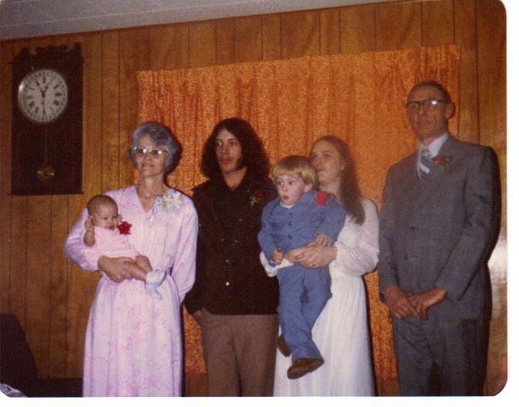
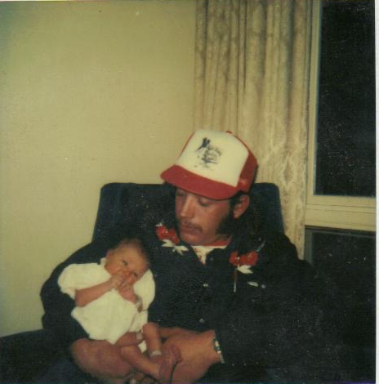
Angela (Angie) Kaye Witt
September 10, 1979 – February 2, 1980
Amy Diane Witt
November 23, 1982 – February 2, 1983

Slide 11
Consequences of “Original sin/Infant baptism”
Infant that dies without baptism stands condemned
Some have suggested a scheduled baptism may suffice
What distinction would they apply between infants and the unborn (miscarriage/abortion)
Eternal Condemnation before they could ever make a decision for themselves

Slide 12
Angela (Angie) Kaye Witt
September 10, 1979 – February 2, 1980
Amy Diane Witt
November 23, 1982 – February 2, 1983

