Slide 2
John 20:19-31

Slide 3
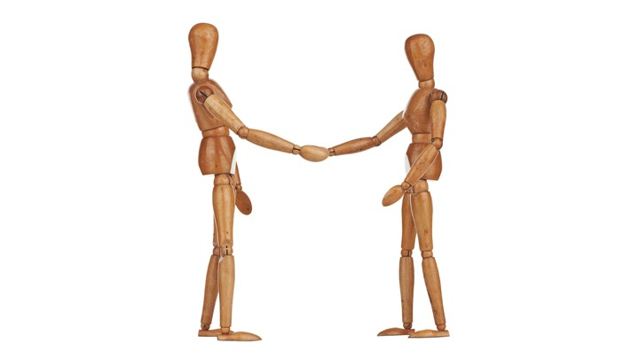

Slide 4
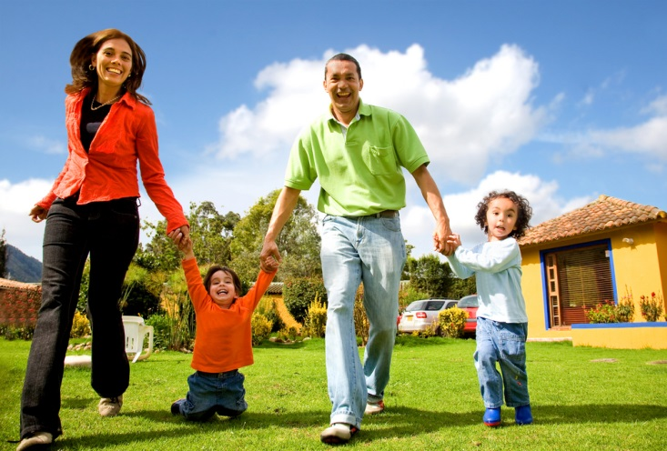

Slide 5
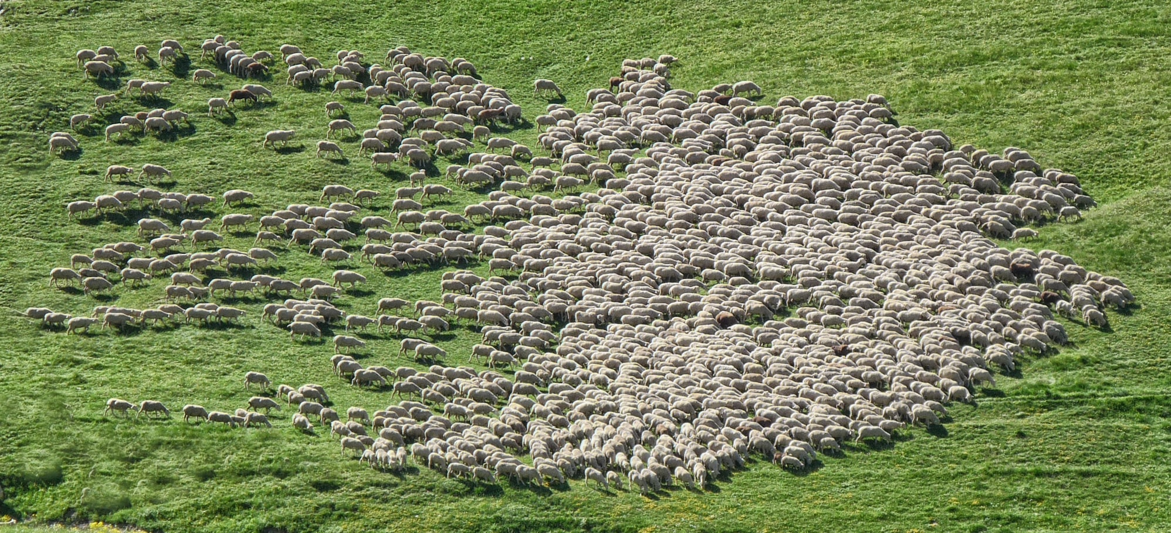

Slide 6
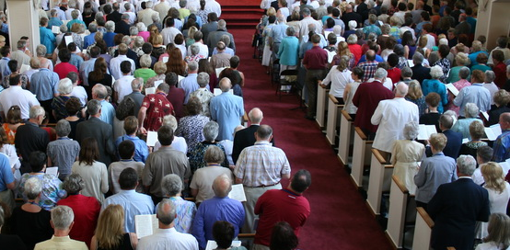

Slide 7
Ekklesia
Gathering Out of Homes to a Public Place
Public Assembly for Deliberation
Christians Gathered for Worship

Slide 8
The Body
Fit and Knit Together
Promotes Growth for Self-Health
Each Part Must Function Properly

Slide 9
Why?

Slide 10
John 20:19-31
Jesus Appears on Resurrection Day
Everyone Was There…
…Except Thomas!

Slide 11
Proof of the Unseen

Slide 12
Thomas Said…
If I Don’t See…
…If I Can’t Touch…
…I will NEVER Believe!

Slide 13
The Gathering with Jesus
Jesus bid them peace,
and encouraged them to be
spiritually-minded

Slide 14
Two Mind-Sets
Fleshly = Death
Spiritual = Life and Peace

Slide 15
The Spiritual Mind of Christ
See Things Like Jesus
Think About Things Like Jesus
Act Like Jesus

Slide 16
Their Faith Strengthened
They Knew What Would Happen to Jesus
Faith Waned Upon News of His Death
Jesus Restored Their Joy and Faith!

Slide 17
Other Benefits
Jesus Reminded Them of Their Mission and Responsibility as His Disciples
Received the Holy Spirit

Slide 18
Thomas Missed Out!
Not Encouraged to be Christ-Minded
Remained Weak and Doubting
Didn’t Receive the Holy Spirit

Slide 19
Hebrews 10:19-27

Slide 20
As Christians, We Must:
Draw Near to God With a True Heart
Not Waver, Steadied by Strong Faith
Promote Love and Good Works

Slide 21
How?

Slide 22
The Road to Success
Lay Aside Sin that Undermines Success
Act According to God’s Will
God Wills Us to Worship Together

Slide 23
The Sad Irony
Thomas Missed “Just One” Meeting
The Lord Came!

Slide 24
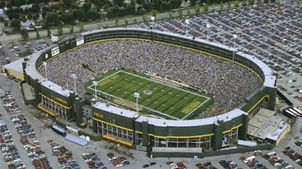
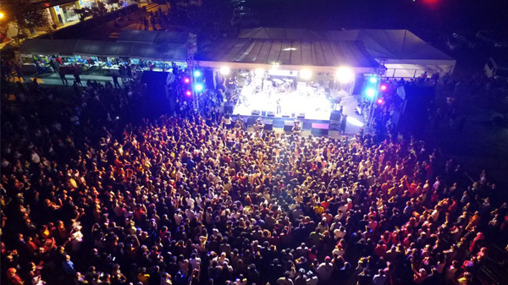

Slide 26
Where?

Slide 27
What if…?

