Slide 1
Joseph: faithfulness during adversity
Genesis 40

Slide 2
Faithfulness during adversity
Adversity Brings Great Opportunities
“Prison Epistles” written by Paul.
Paul’s difficulties: 2 Cor. 12:7; 11:23-28
John wrote ‘Revelation’ while in exile.
Moses in adversity. Heb. 11:24-29

Slide 3
Faithfulness during Adversity
Adversity Promotes Spiritual Maturity
Job 42:5,6
“Iron came into his soul...” Psa. 105:16-19

Slide 4
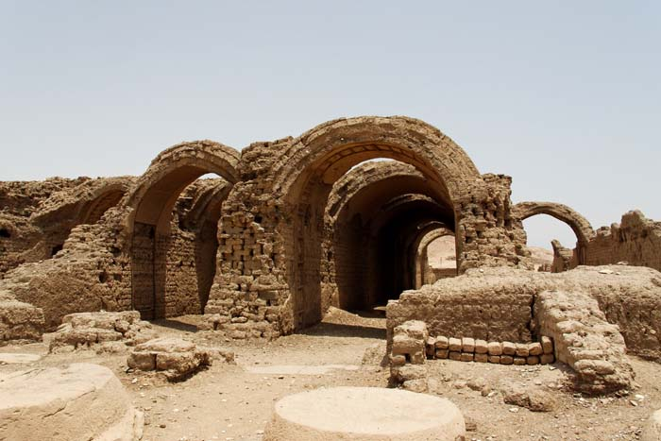

Slide 5
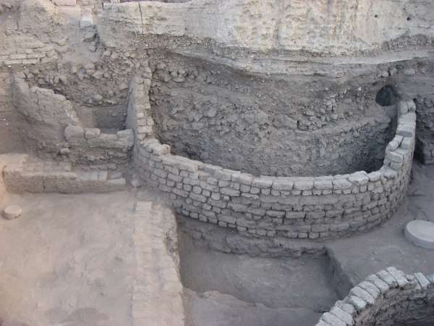

Slide 6
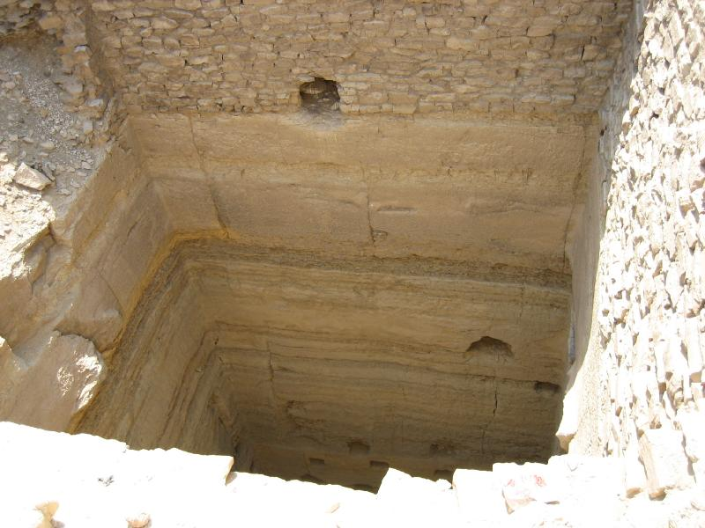

Slide 7
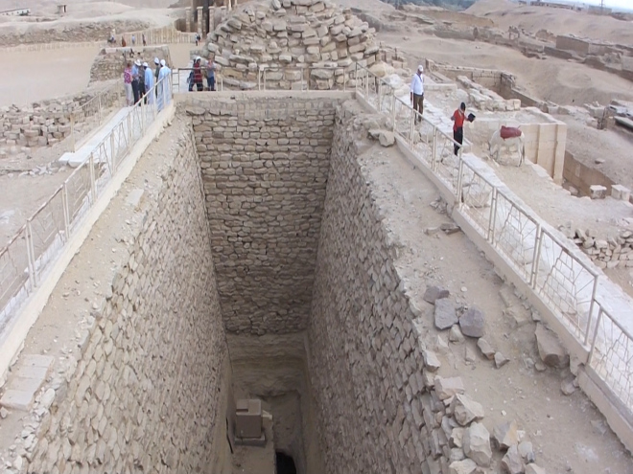

Slide 8
Faithfulness during Adversity
Adversity Promotes Spiritual Maturity
Job 42:5,6
“Iron came into his soul...” Psa. 105:16-19
“Out of weakness made strong…” Heb. 11:32-34
God wants ‘iron-souled’ saints. Eph. 6:10-17

Slide 9
Faithfulness during adversity
Adversity Proves Our Integrity
“Problems don’t make us the way we are…
problems reveal what we are.”
Strength is revealed during adversity. Mt. 7:24-27
Esther

Slide 10
Faithfulness during adversity
Reputation is what’s chiseled on your tombstone…character is what the angels say about you around the throne of God.

Slide 11
Faithfulness during adversity
Adversity Produces Dependency
“Without Me you can do nothing.” John 15:5
The Lord was with Joseph in prison. Gen. 39:20-21
We are just as dependent upon God in good
times as in bad…we are just not sensitive to it.

Slide 12
Faithfulness during adversity
Adversity Prepares us for Service
Joseph became sensitive to the needs of
others.
Sometimes, in the midst of our trial, God lets us
reach out and minister to others. 1 Pet. 3:8,9

